Slide 1


PROJECT B.A.T.
A Google Earth Pro To Minecraft
Blueprint Automation Tool
Kevin Green
B.S. Computer Science
1

Slide 2


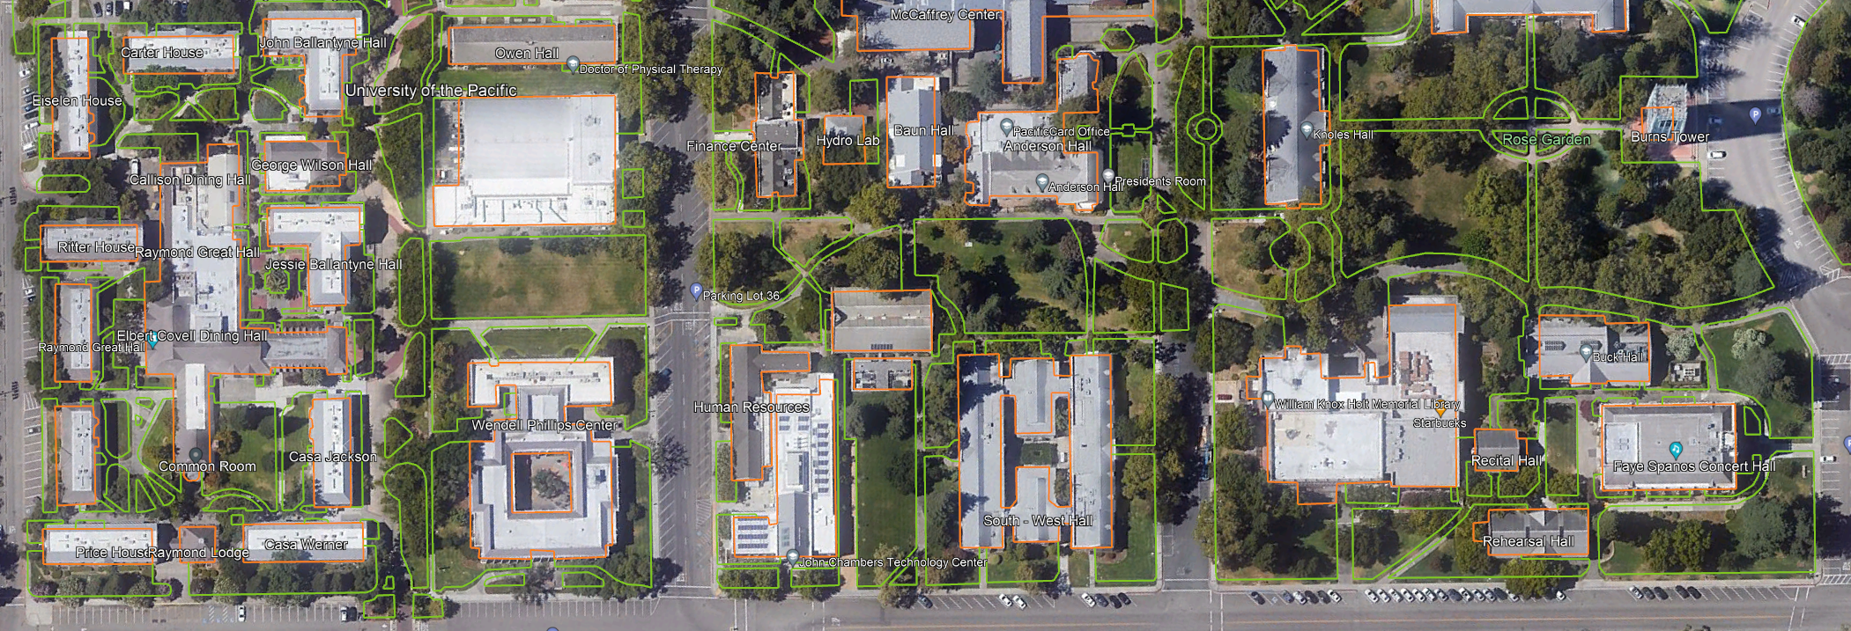

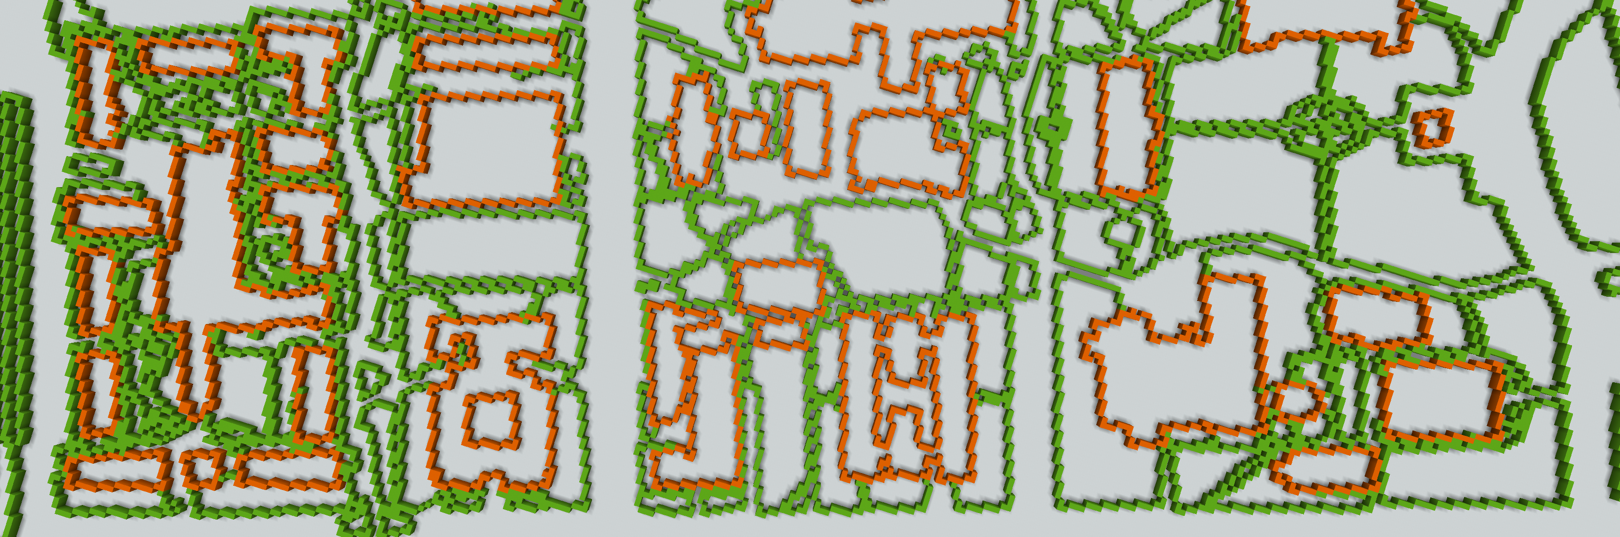

BACKGROUND
Building Real Places
Recreate Real Places in Minecraft
Creative Challenge For Players
Examples: Monuments, Theme Parks
Done To Some Scale (Normally 1:1)
Requires Planning Phase
Creation of Place Blueprints
Google Earth Pro Measurements
Convert Coordinates To Minecraft
Time Consuming & Repetitive
Project B.A.T.
Automates Measurements
Automates Conversions
Automates Blueprint Creation
Satellite View Of U.O.P. Central Campus In Google Earth Pro
50% Scale Plan Of U.O.P. Central Campus Built In Minecraft
Project B.A.T.
2
Notes:
Introduction – Describe the general problem area or research question that your project addresses

Slide 3




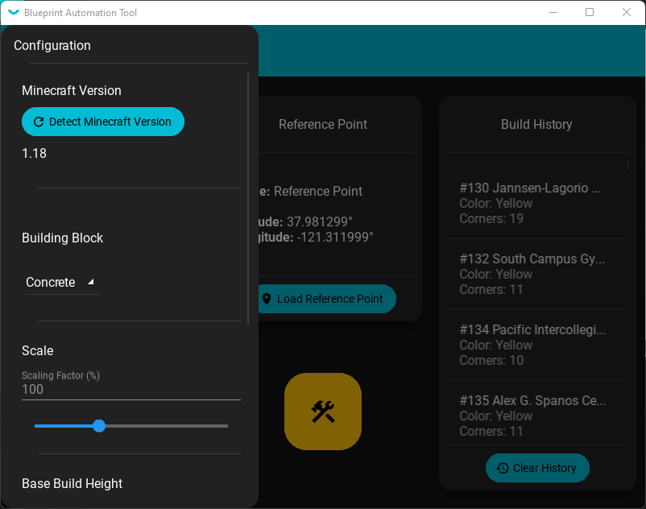
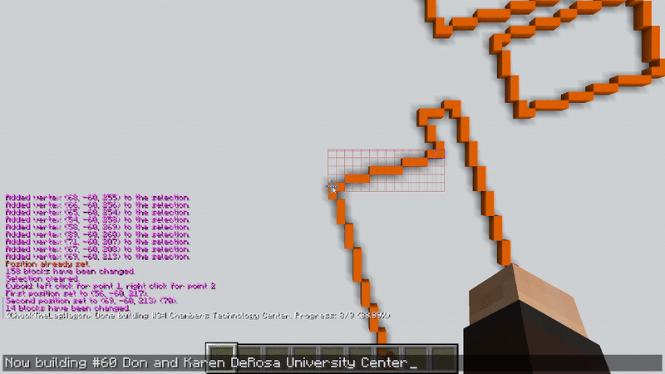
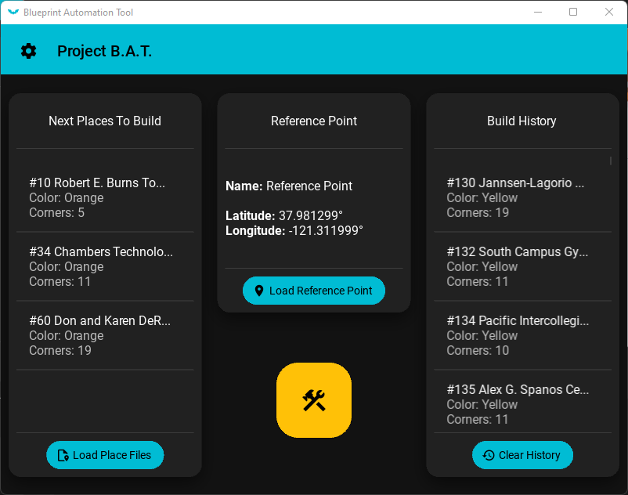
IMPLEMENTATION
Settings
Automation
Interface
Building Block Choices
Scale Of Generated Builds
Base Building Height
Automatic Measurements
Automatic Conversions
Automatic Blueprint Builds
Material Design Interface
Main Automation Menu
Configurable Settings Menu
Project B.A.T.
3
Notes:
Implementation – Describe the application you developed. Do not plan to give a demo of your application (there will not be enough time). Instead, you might want to provide 2-3 screenshots or animated GIF that illustrate the primary functionality of your application. Do NOT embed video or link to YouTube. Make sure it is clear how your application solves the problem or answers the research question you mentioned earlier.

Slide 4



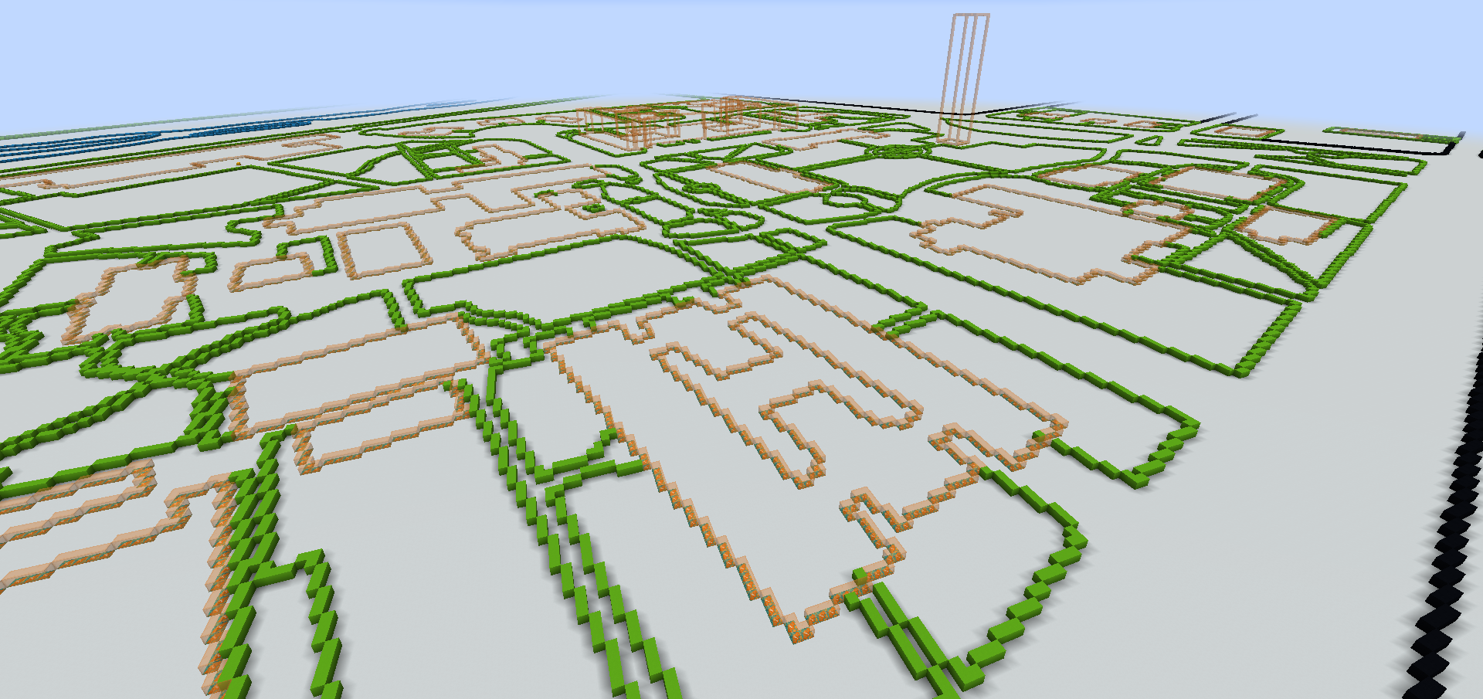
CONCLUSION
Summary
What To Expect
The Problem
Creating In-Game Plans Of Real Places
Repetitive Manual Calculations
Room For Human-Error
The Solution
Automates Calculating Scale
Automates Outline Building
Customizable Build Behavior
Reduced Room For Human-Error
Major Features
Minecraft Automation
User-Controlled Settings
User Interface
Live Demonstrations Of Game Automation
Recreation Of University Buildings Outlines
Building Of 2D and 3D Blueprints
Project B.A.T.
4
Notes:
Introduction – Describe the general problem area or research question that your project addresses

Slide 5
PROJECT B.A.T.
Thank You!
5

